Slide 1
MICROECONOMICS
(BCS 2002 & BSE 2002)/BA]
SPRING-2024
Dr. S. Ghiasul Haq ghiasul786@gmail.com

Slide 2
(C) DEMAND AND SUPPLY

Slide 3
SUPPLY
LECTURE-8

Slide 4
1.What is Supply
Supply, is defined as the amount of a product that would be offered for sale at all possible prices at market prices. Because the producer is receiving payment for his or her products, it should come as no surprise that more will be offered at higher prices. This forms the basis for the Law of Supply.

Slide 5
2.LAW OF SUPPLY
According to law of supply There is a direct relationship between price and quantity supplied. The law of supply can be defines as other things being remaining constant, the quantity of the goods produce and offered for sale will increase as the price of goods rises and decrease as the price fall.
The law is based upon the economic sense that at higher the price the greater amount of profit can be earned and thus the greater the incentives to produce the goods and offer it for sale.

Slide 6
….2.LAW OF SUPPLY
When price
goes
up
Quantity supplied
Goes
up
Quantity
supplied
goes down
When price
Goes
down

Slide 7
…2.Law of Supply
Price Rs | Goods Supplied (000 KGs)
10 | 100
20 | 200
30 | 300
40 | 400
50 | 500

Slide 8
3. Supply Function Qs = 10 + 5P
SUPPLY (000 KGs) & PRICE (Rs.Per Kg)
Supply Schedule of Vegetable
Price Per KG | Supply
[Rupees] | [KG-000]
10 | 60
15 | 85
20 | 110
25 | 135
30 | 160
35 | 185
40 | 210
45 | 235
50 | 260

Slide 9
4. CHAGE & SHIFT IN SUPPLY
Price | Supply-1 | Supply-2
Per Unit | [000] | [000]
5 | 0 | 10
10 | 25 | 50
15 | 50 | 100
17 | 60 | 120
20 | 75 | 150
22 | 85 | 170
25 | 100 | 200

Slide 11
5. THE SUPPLY SHIFTERS [Non-Price Determinants of Supply]
Number of Products: A successful new product or service always brings out competitors who initially raise overall supply.
Input Costs: Input costs, the collective price of resources that go into producing a good or service, affect supply directly
Examples
Minimum Wage increases
Cost of cotton increases, supply of textile fabrics decreases

Slide 12
5 ……Supply Shifters
3. Labor Productivity: Better trained or more-skilled workers are usually more productive. Increased productivity decreases costs and increases supply.
4. Technology: By applying scientific advances to the production process, producers have learned to generate their goods or services more efficiently.
5. Government Action: Government actions, such as taxes or subsidies, can have a positive or negative effect on production costs.
6. Number of Sellers: When number of sellers increases, supply increases and # of sellers decreases, supply decreases
7. Producer Expectations :The amount of a product that producers are willing and able to supply may be influenced by whether they believe prices will go up or down.

Slide 13
6.ELASTICITY OF SUPPLY
Measures the responsiveness of a change in the quantity supplied of a good to a change in its price
Ranges from zero (vertical supply curve-crossing X-axis) to infinity (horizontal supply curve-crossing Y-axis)
Longer period of adjustment, greater is the elasticity of supply

Slide 14
….6 ELASTICITY OF SUPPLY
The responsiveness of supply to price changes.
(DS/S)/(DP/P), percent change in quantity supplied divided by percent change in price.
Usually positive.
Price Elasticity of Supply is:
%ΔQs ÷ %ΔP
ΔQ=Change in quantity supplied
ΔP=Change in unit price of the product

Slide 15
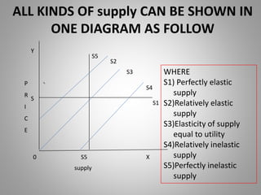

Slide 16
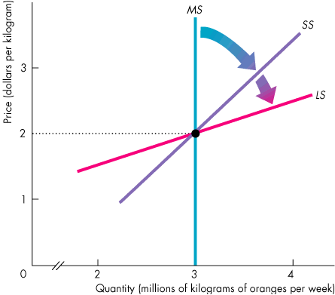
…..6.Elasticity of supply
Market Supply (MS) is zero elastic
Short-Run(SS) is inelastic
Long-Run(LS) is elastic

Slide 17
POINT & ARC ELASTICITY of Supply
Elasticity =%ΔQ ÷ %ΔP
Point Elasticity: [ΔQ/ Q]÷[ΔP/P]
Arc Elasticity:
[ΔQs/ (Qs1+Qs2)]÷[ΔP/(P1+P2)]
[Illustration with Example –Next Slide]

Slide 18
Price
Supply Curve
20 Rs.
10 Rs.
10
Quantity Supplied (000 Kgs)
30

Slide 19
POINT & ARC ELASTICITY of SUPPLY:
Price Increases from Rs-10 to Rs 20 per KG & Supply Increases from 10 to 30 thousands:
POINT ELASTICITY:
Ę=[ΔQs/ Qs]÷[ΔP/P] = [20/30] ÷[10/20]=1.3
ARC ELASTICITY:
Ę=[ΔQs/ (Qs1+Qs2)]÷[ΔP/(P1+P2)]
=
[20/(20+30] ÷[10/10+20)]=1.2

Slide 20
Point Elasticity
Supply Function Qs = a + bP
Supply Function Qs = 10 + 5P
Point Elasticity = Slope X P/Q
e.g. Price Rs.10 per KG
Therefore:
Supply 60 (000) KG
Point Elasticity of Supply is:
5 X (10 ÷ 60)
5 X1/6 = 5/6 = 0.83

